Slide 1
Leveraging Data Science to Predict Personality Types: An MBTI Classification Project
Byrnes Mulumbeni
Laura Mwibashiye
Uyenmy Nguyen
DATA 3421: FINAL PROJECT
MONDAY, APRIL 21ST 2025

Slide 2
Table of contents
Background
& Motivations
Research Questions
& Methodology
01
02
Exploratory Data Analysis
& Data Preprocessing
ML Models &
Comparison
03
04
All Model Comparison
& Best Model
Challenges
& Future Work
05
06

Slide 3
01
Background & Motivations
MBTI
MYERS BRIGGS
What is our project about?

Slide 4
Background & Motivations
Background:
The Myers-Briggs Type Indicator (MBTI) is a widely used framework for classifying individuals into one of 16 personality types based on four key dimensions: Extraversion vs. Introversion, Sensing vs. Intuition, Thinking vs. Feeling, and Judging vs. Perceiving.
Motivations:
Advancing Machine Learning Techniques: The project offers an opportunity to experiment with different machine learning models, data preprocessing, feature selection, and hyperparameter tuning to improve prediction accuracy.
Data-Driven Insights: By automating personality prediction, we can uncover valuable insights into which features (demographic or behavioral) are most predictive of personality types, enhancing our understanding of human behavior.

Slide 5
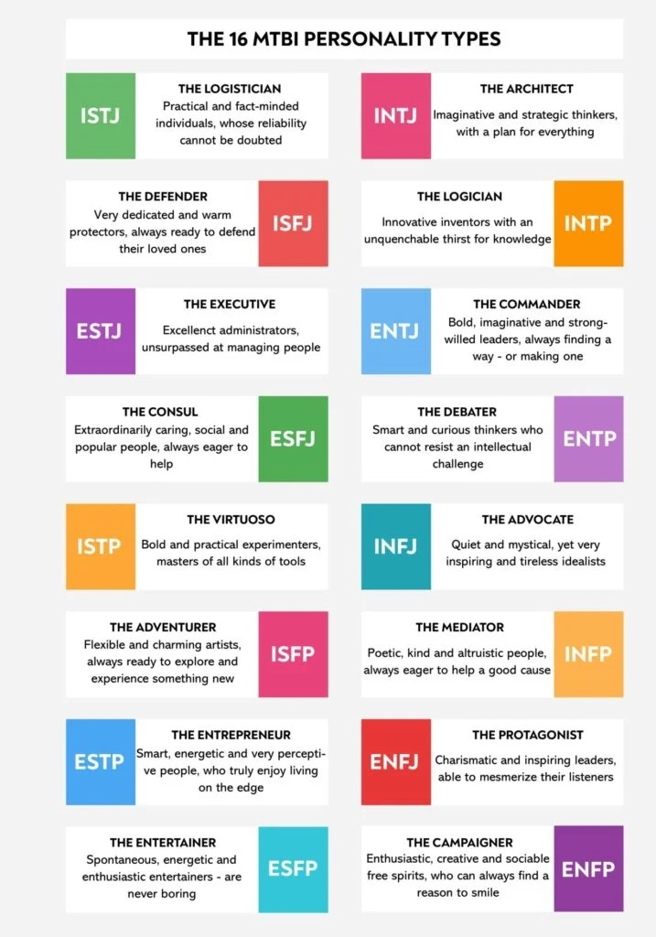
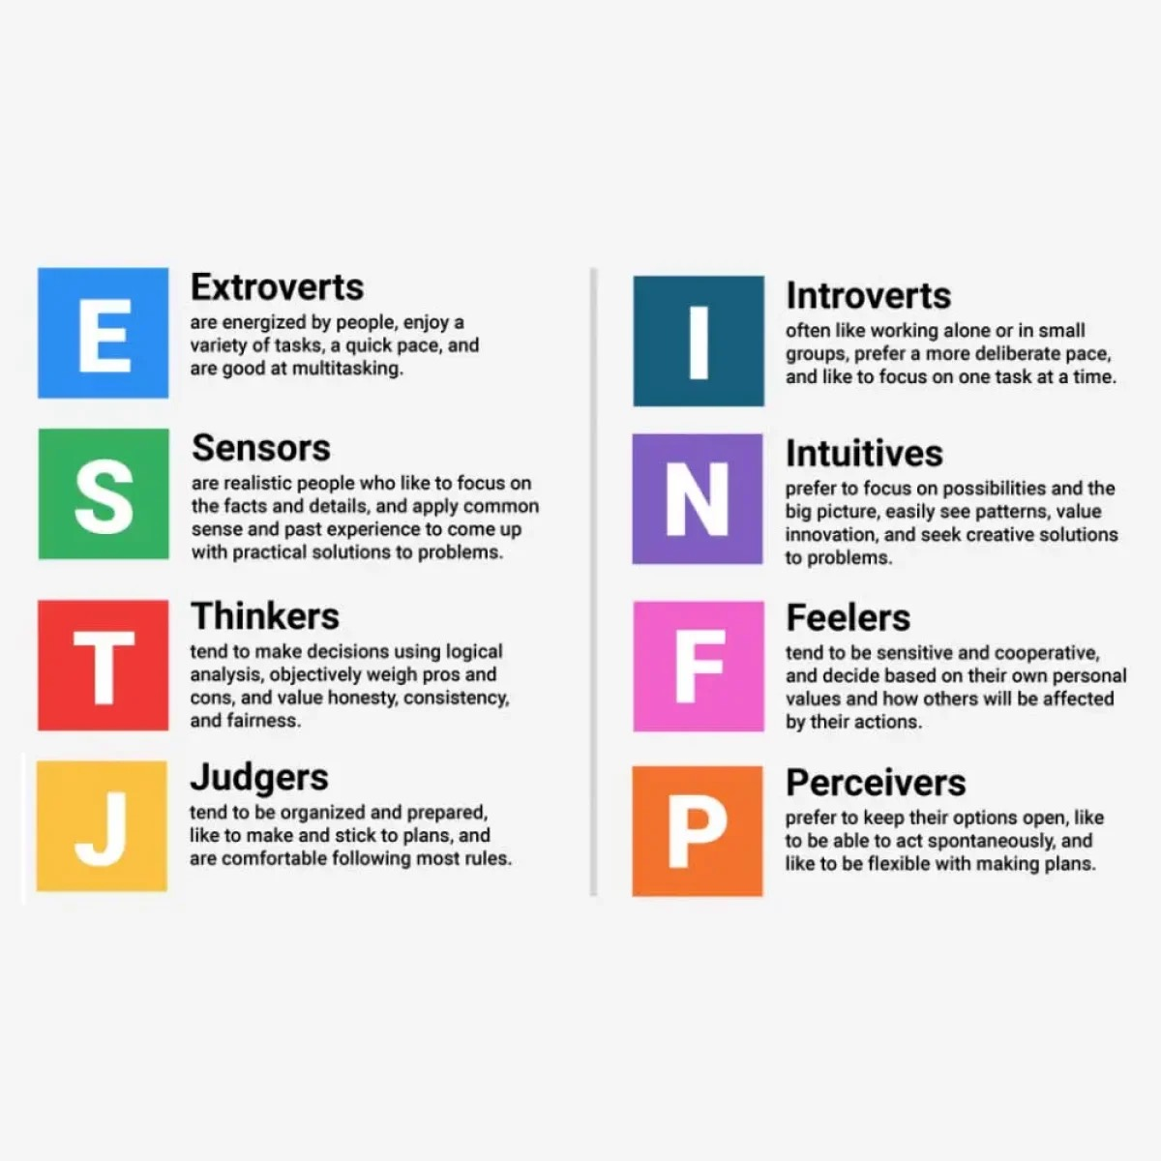
Pop Quiz! What is your MBTI?

Slide 6
02
Research Questions
& Methodology
MBTI
MYERS BRIGGS
What is our project about?

Slide 7
Research Questions and Methodology
1. Which features of the dataset contribute most to predicting a person's MBTI personality type?
Methodology: Use feature importance from Random Forest. Correlation analysis for numerical features.
2. How do preprocessing steps like handling outliers and feature selection affect model performance?
Methodology: Compare model performance before and after outlier removal and feature selection using evaluation metrics.
3. Which machine learning model performs best for predicting MBTI personality types?
Methodology: Train multiple models and compare their performance metrics.
4. Does hyperparameter tuning improve the performance of machine learning models?
Methodology: Perform hyperparameter tuning using GridSearchCV, and compare model performance.

Slide 8
03
Exploratory Data Analysis
& Data Preprocessing
MBTI
MYERS BRIGGS
What is our project about?

Slide 9
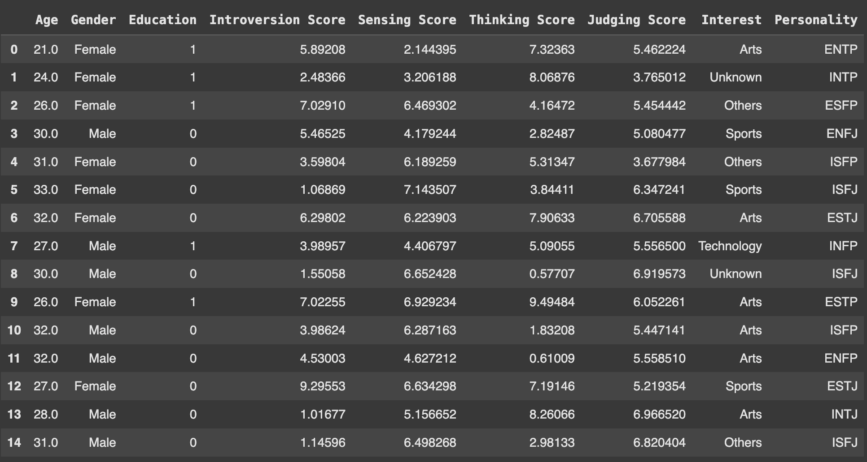
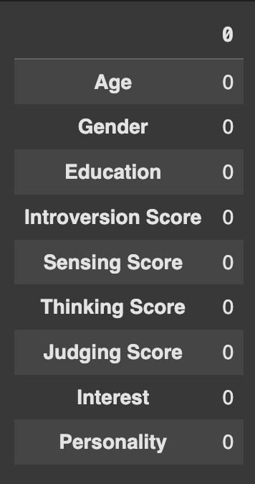
Data Exploration: first 15 rows & Missing Values

Slide 10
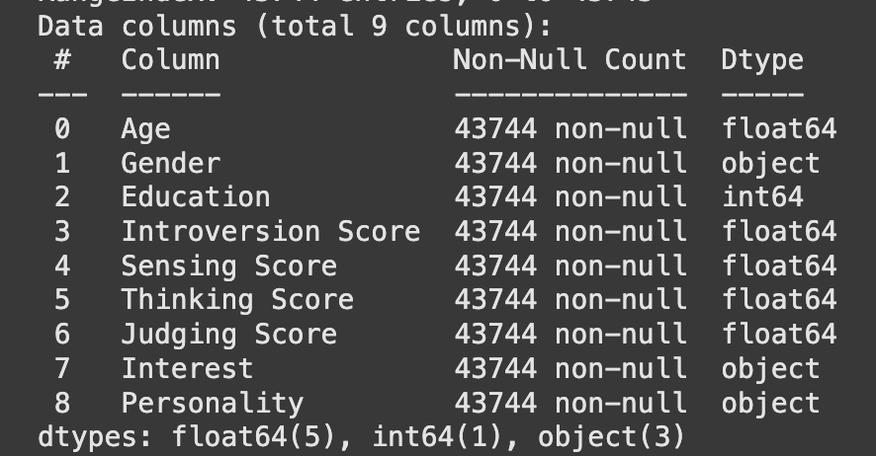
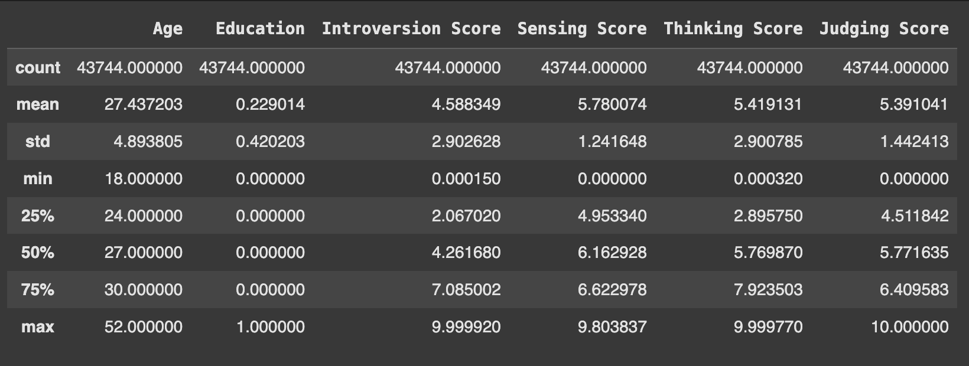
Data Exploration: Info & Summary of Statistics

Slide 11
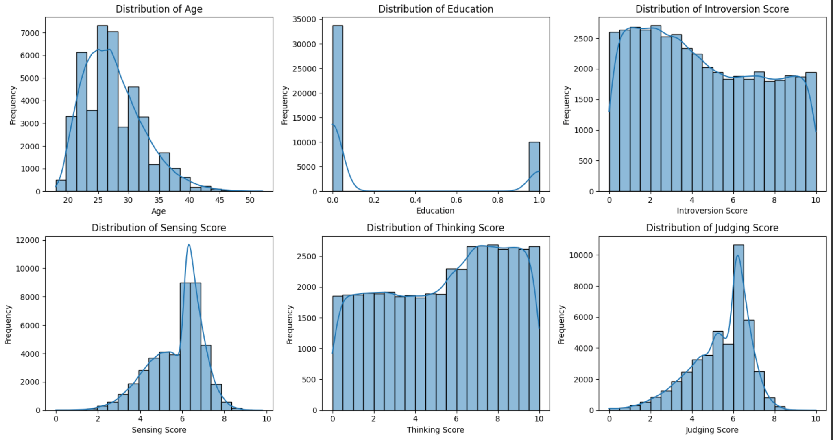
Data Exploration: Distribution of Numerical features

Slide 12
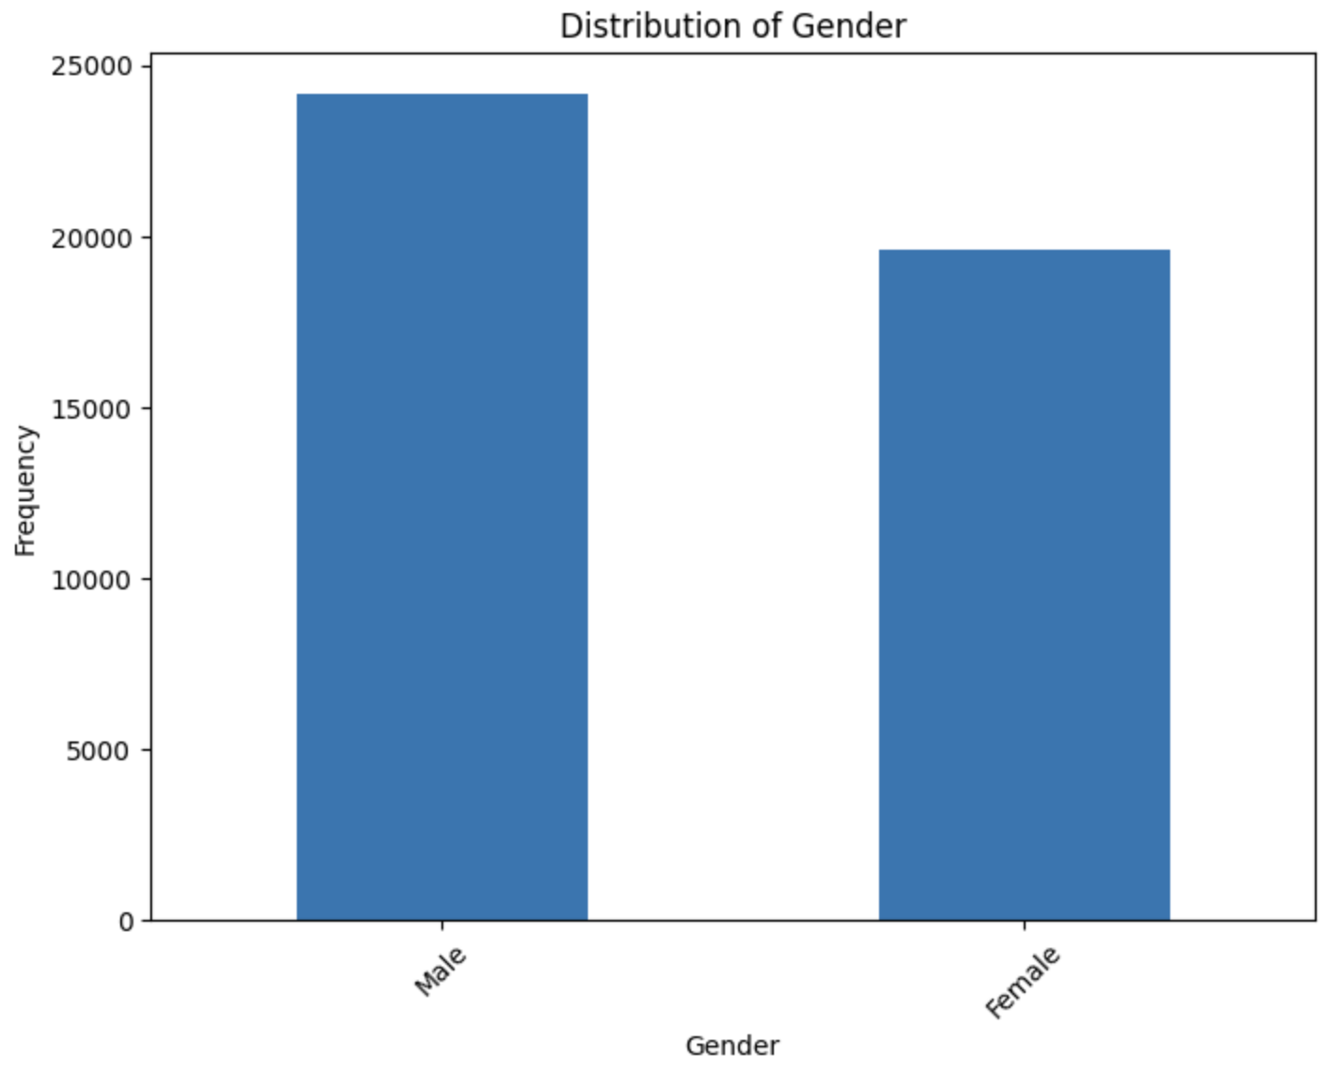
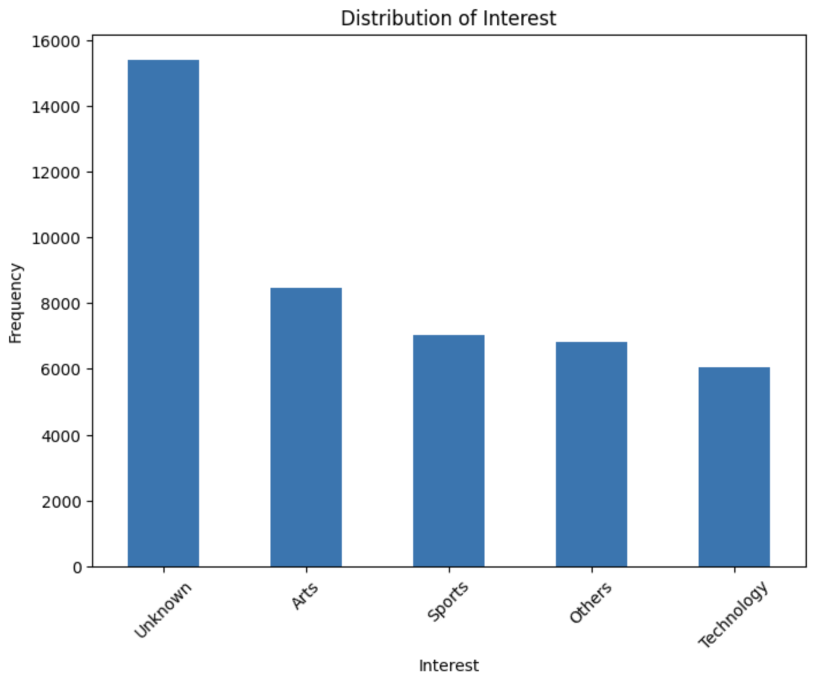
Data Exploration: Distribution of categorical features

Slide 13
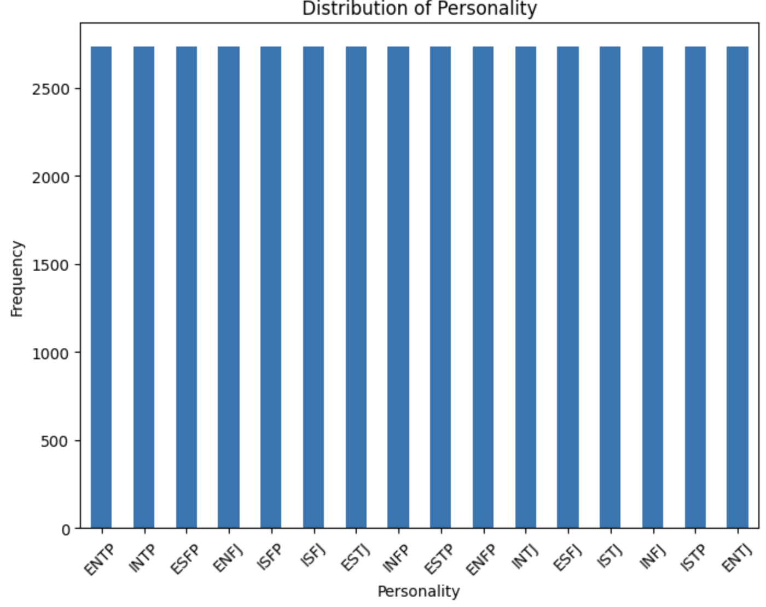
Data Exploration: Distribution of Target

Slide 14
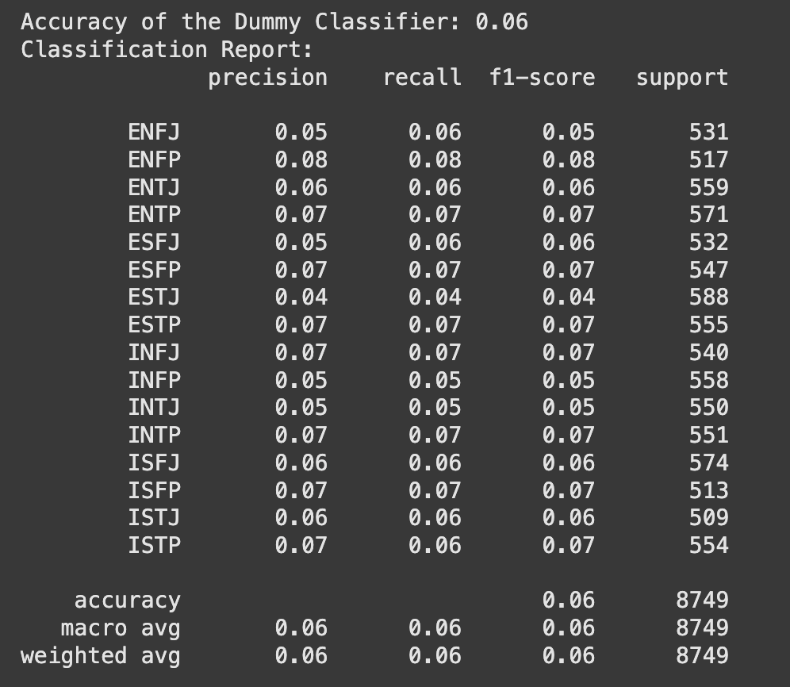
Data Exploration: Baseline Model

Slide 15
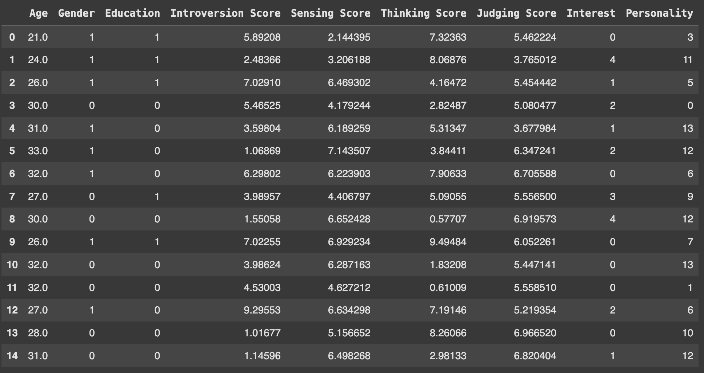
Data Preprocessing: Label Encoding

Slide 16
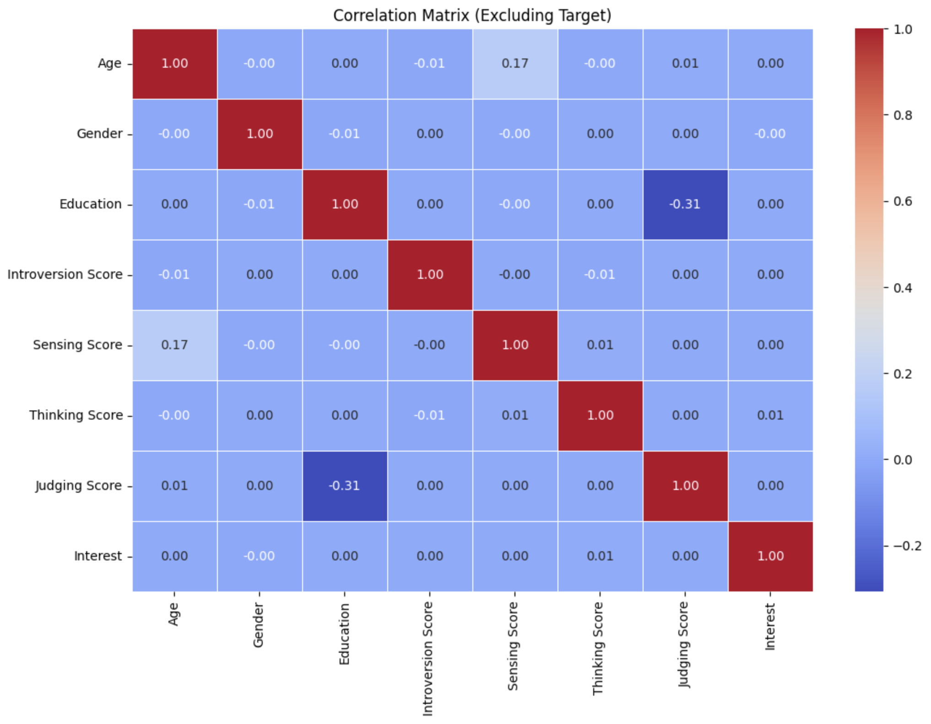
Data Preprocessing: Multicollinearity

Slide 17
04
ML Models &
Comparison
MBTI
MYERS BRIGGS
What is our project about?

Slide 18
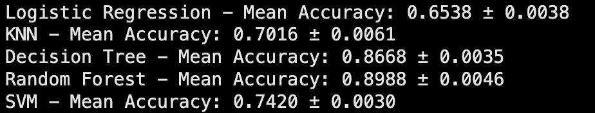

ML Models: Models Selection

Slide 19
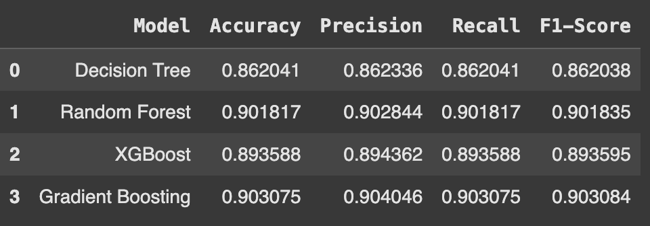
ML Models: First Results

Slide 20
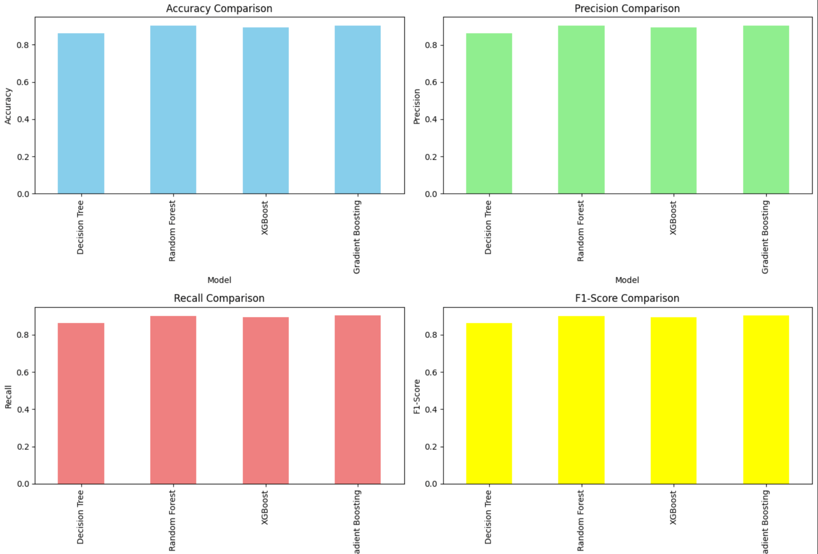
ML Models: First Results

Slide 21
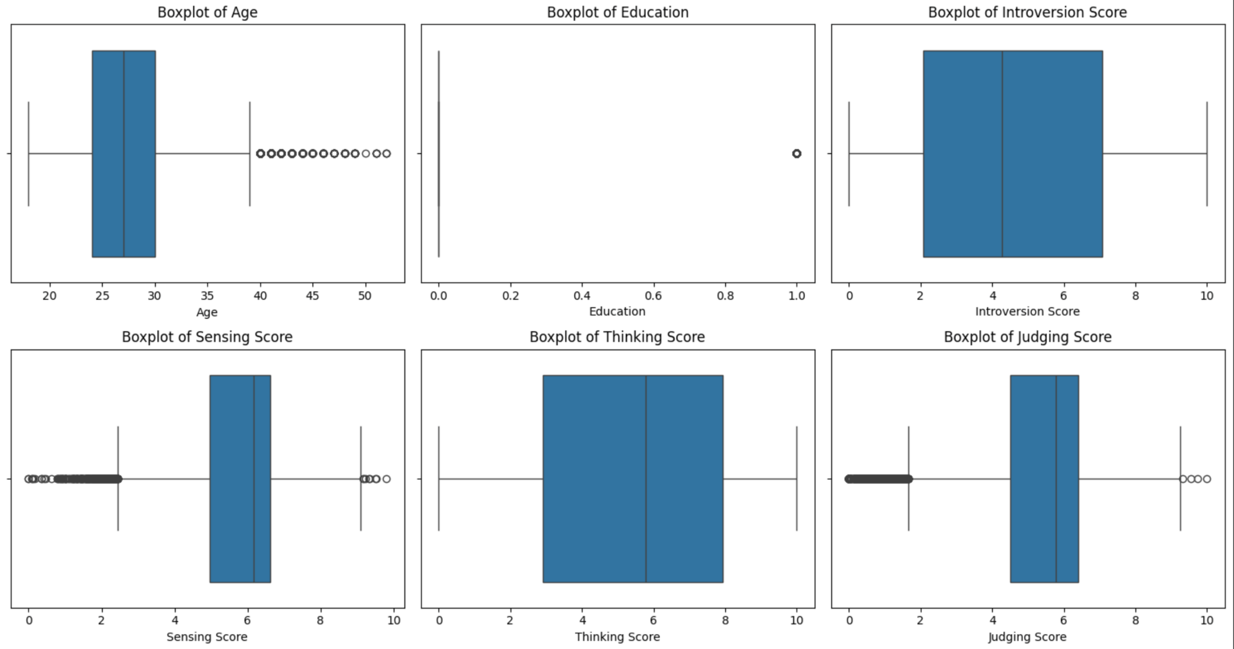
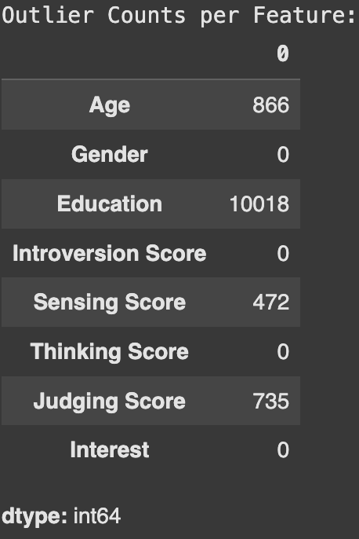
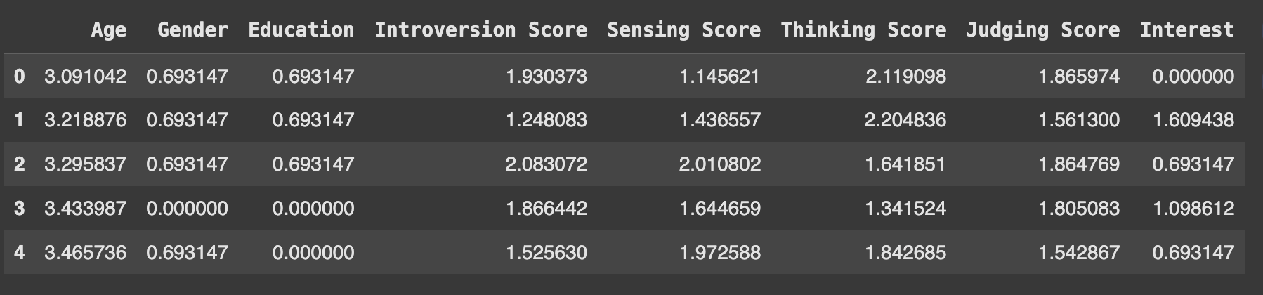
Data Preprocessing: Handling Outliers

Slide 22
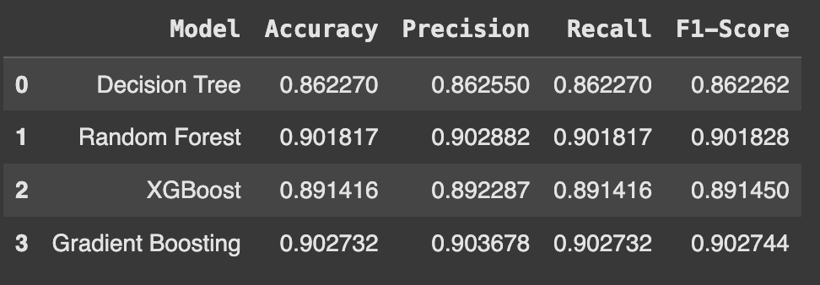
ML Models: Second Results

Slide 23
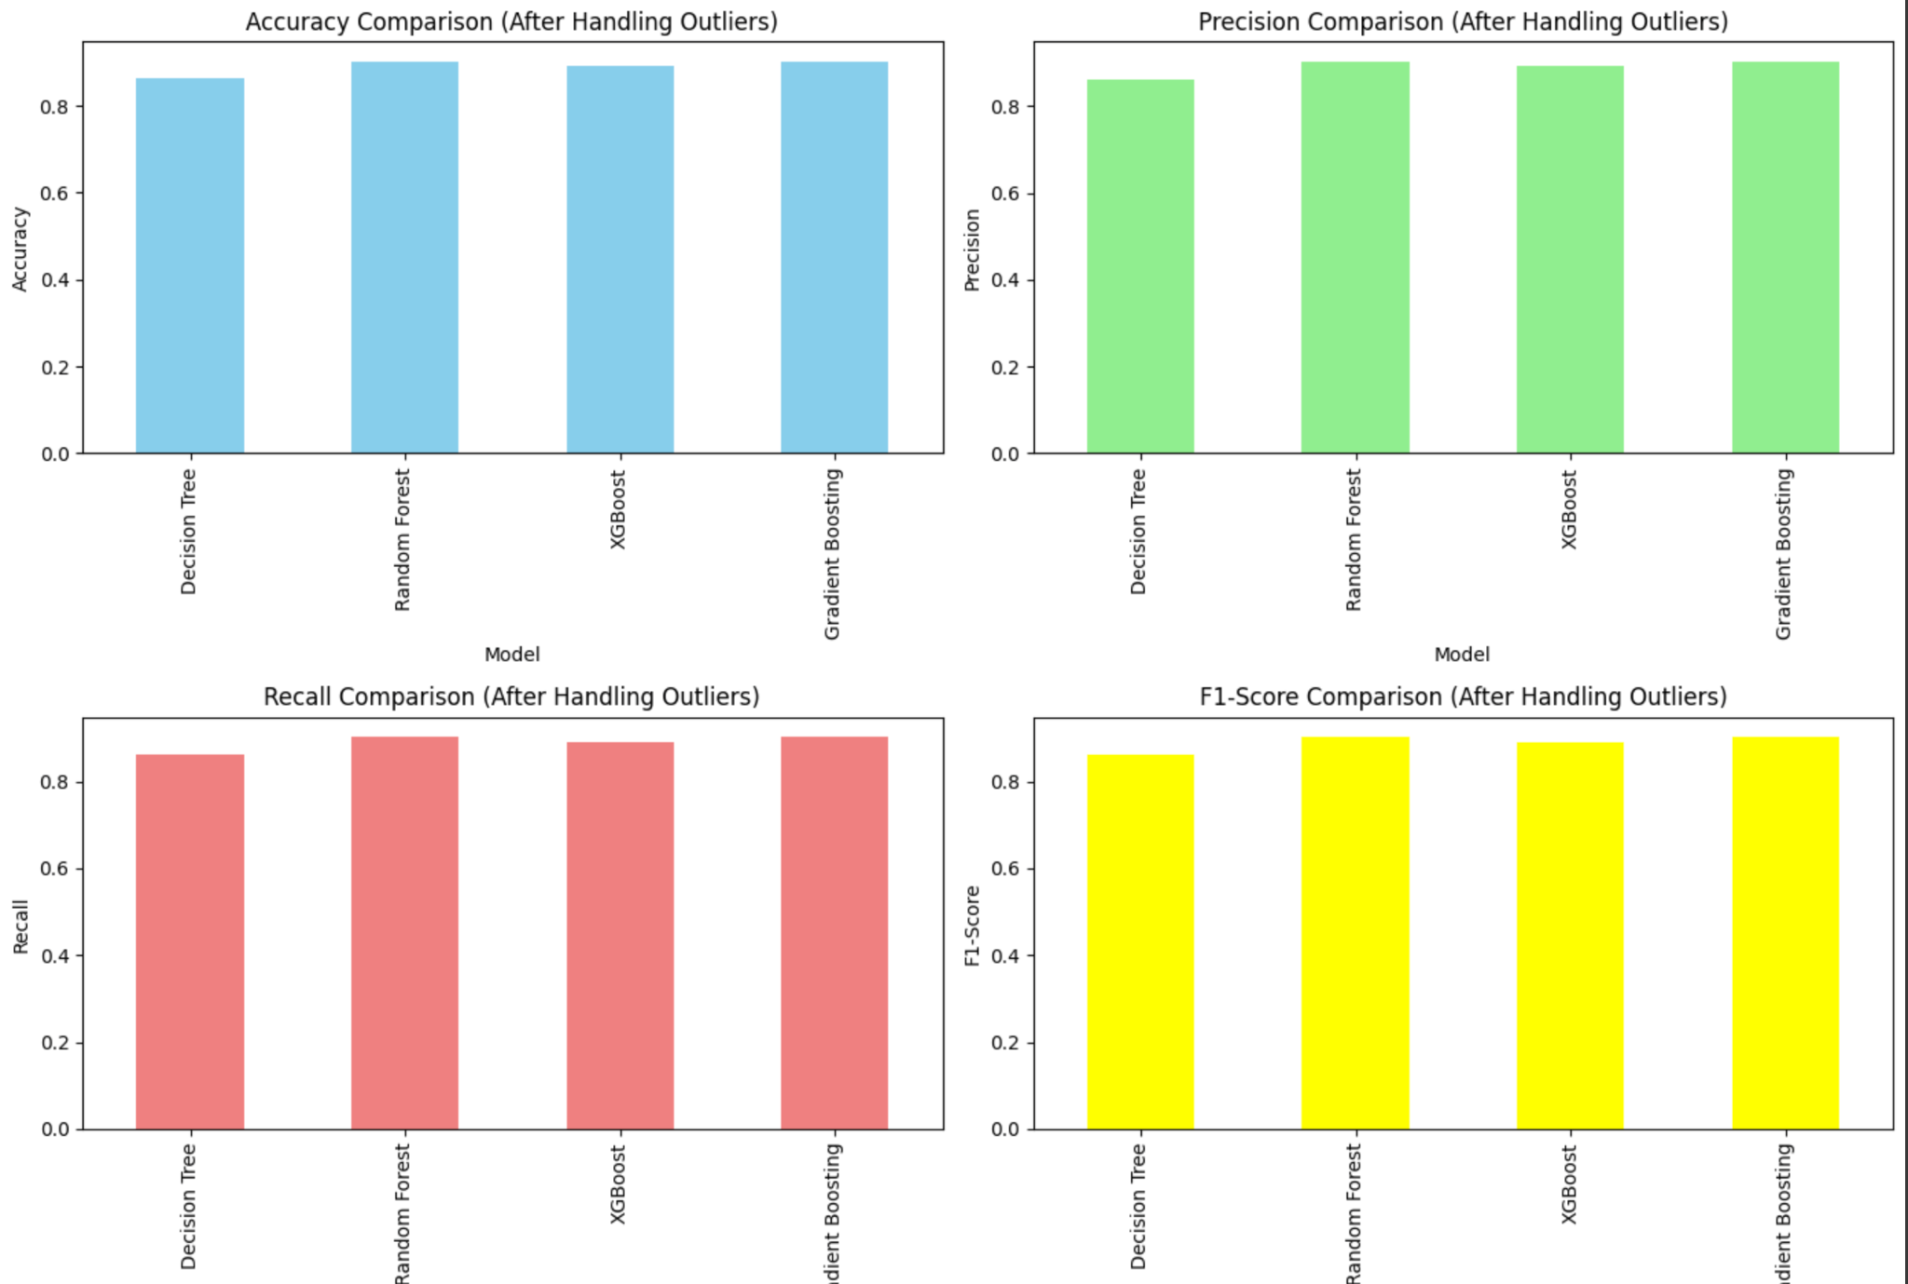
ML Models: Second Results

Slide 24
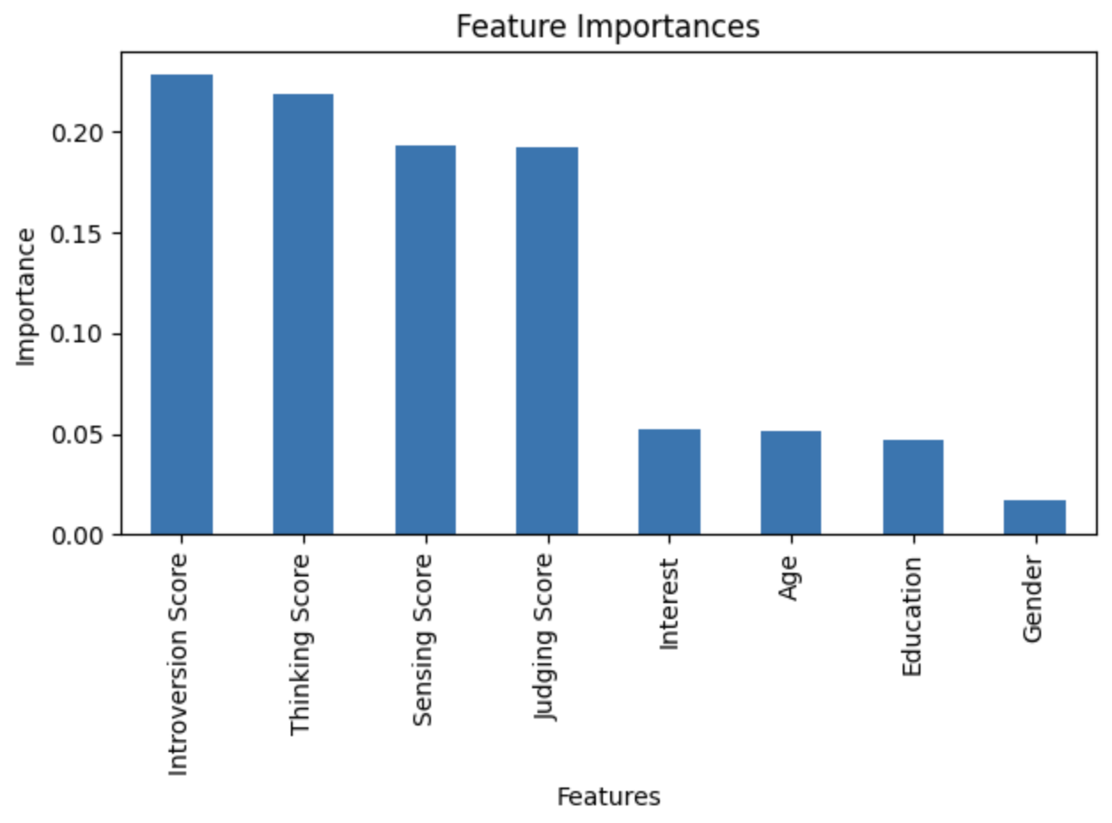
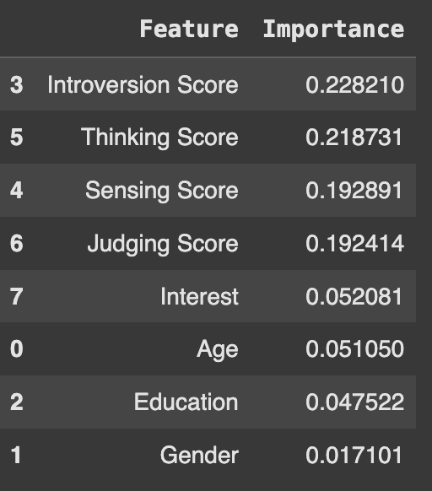
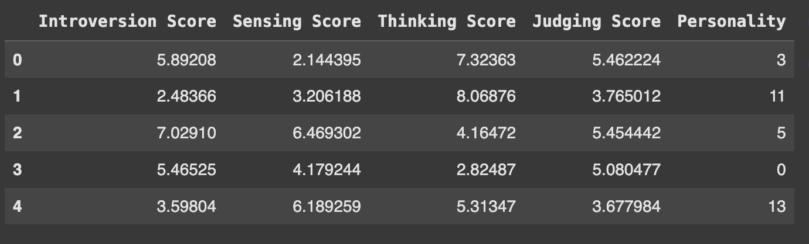
Data Preprocessing: Features Selection

Slide 25
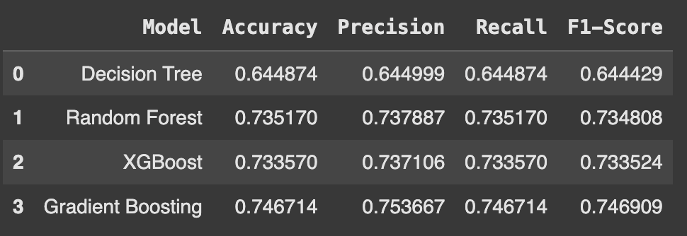
ML Models: Third Results

Slide 26
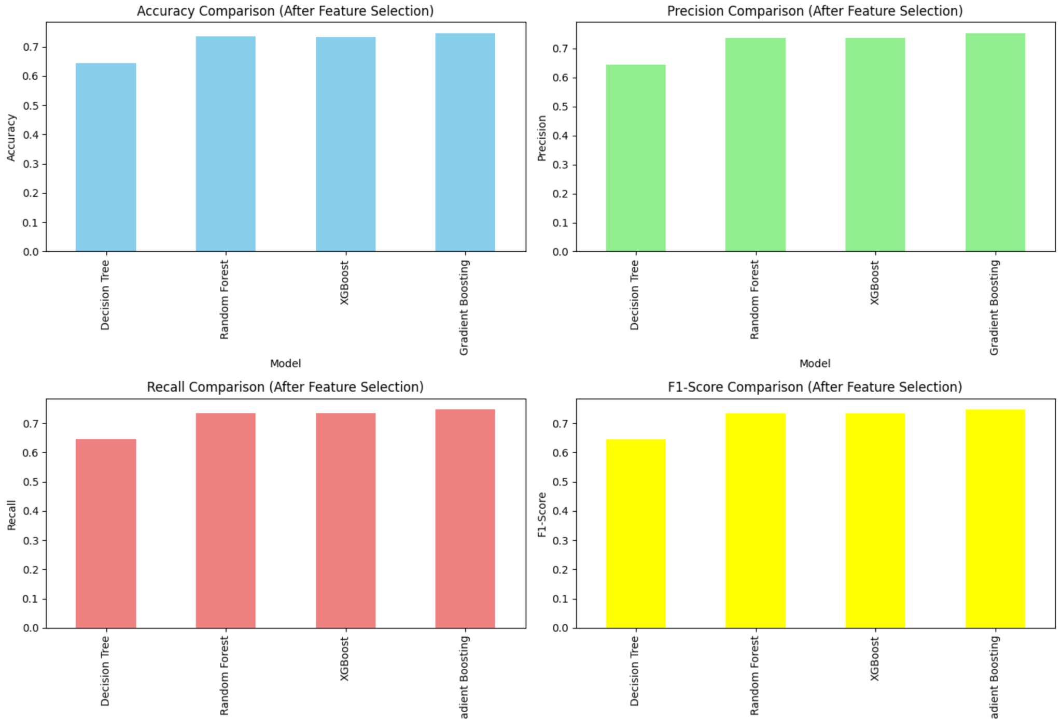
ML Models: Third Results

Slide 27
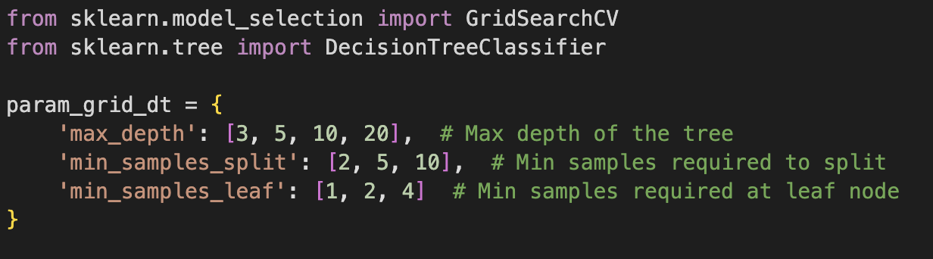
ML Models: Tuning

Slide 28
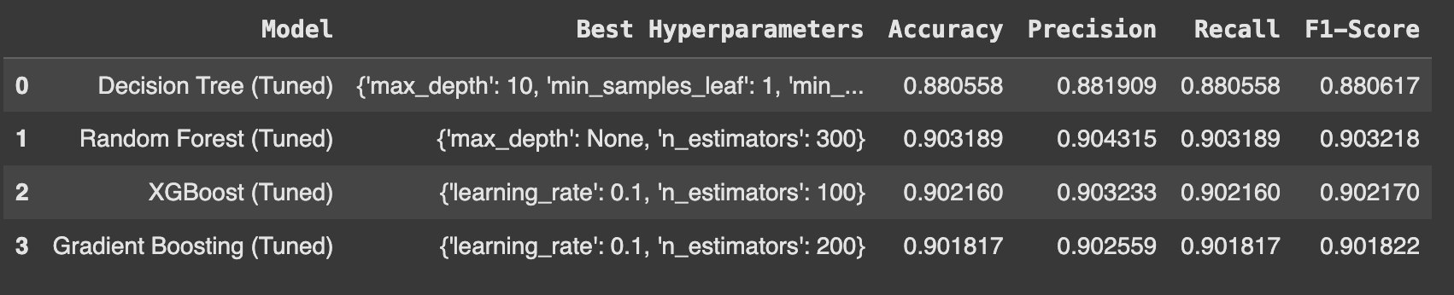
ML Models: Fourth Results (Tuning)

Slide 29
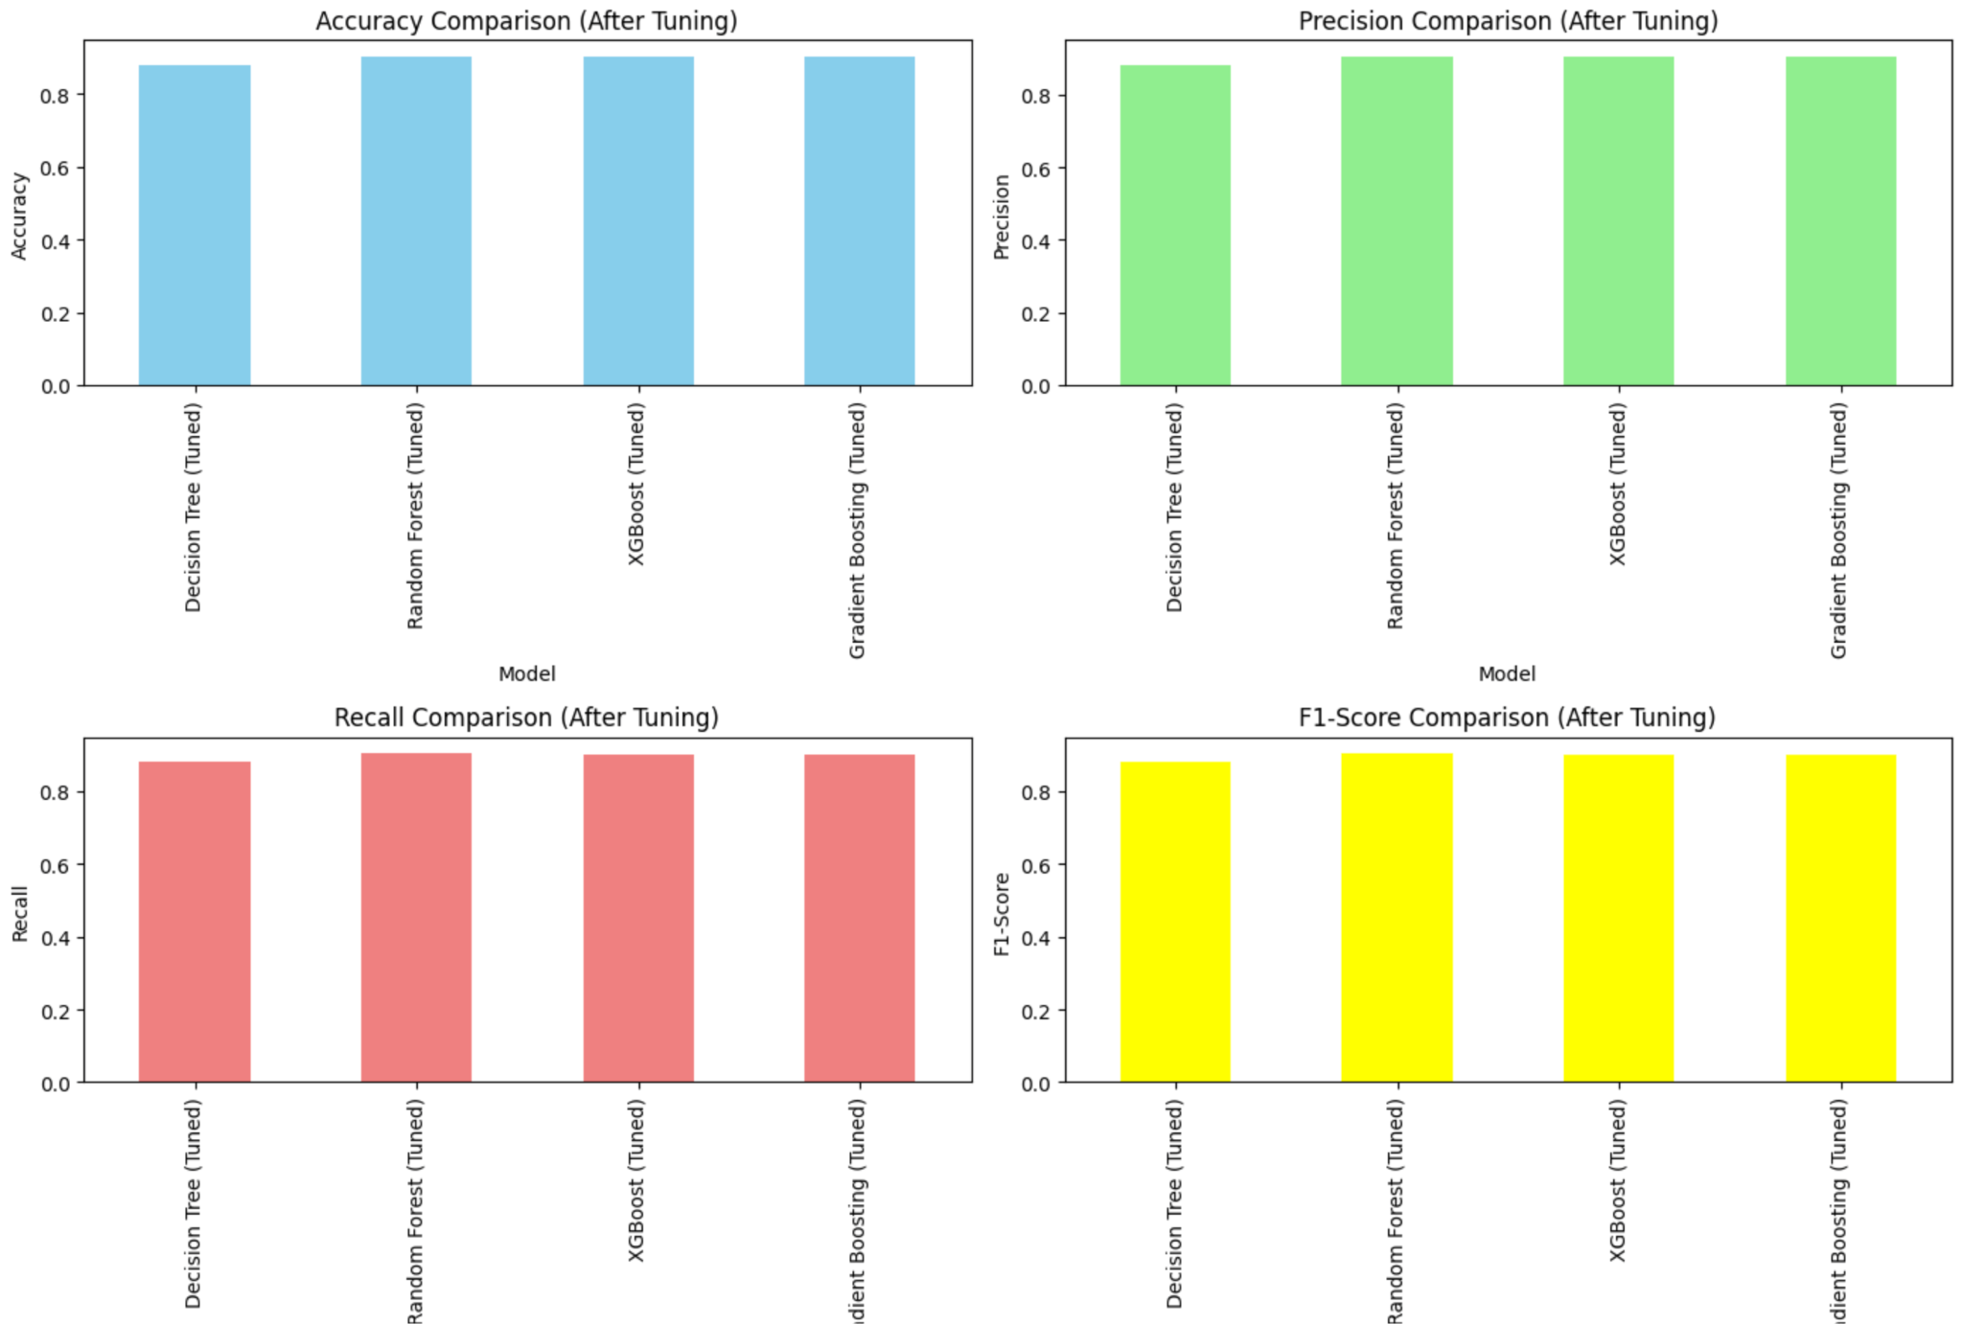
ML Models: Fourth Results

Slide 30
05
All Models Comparison
& Best Model
MBTI
MYERS BRIGGS
What is our project about?

Slide 31
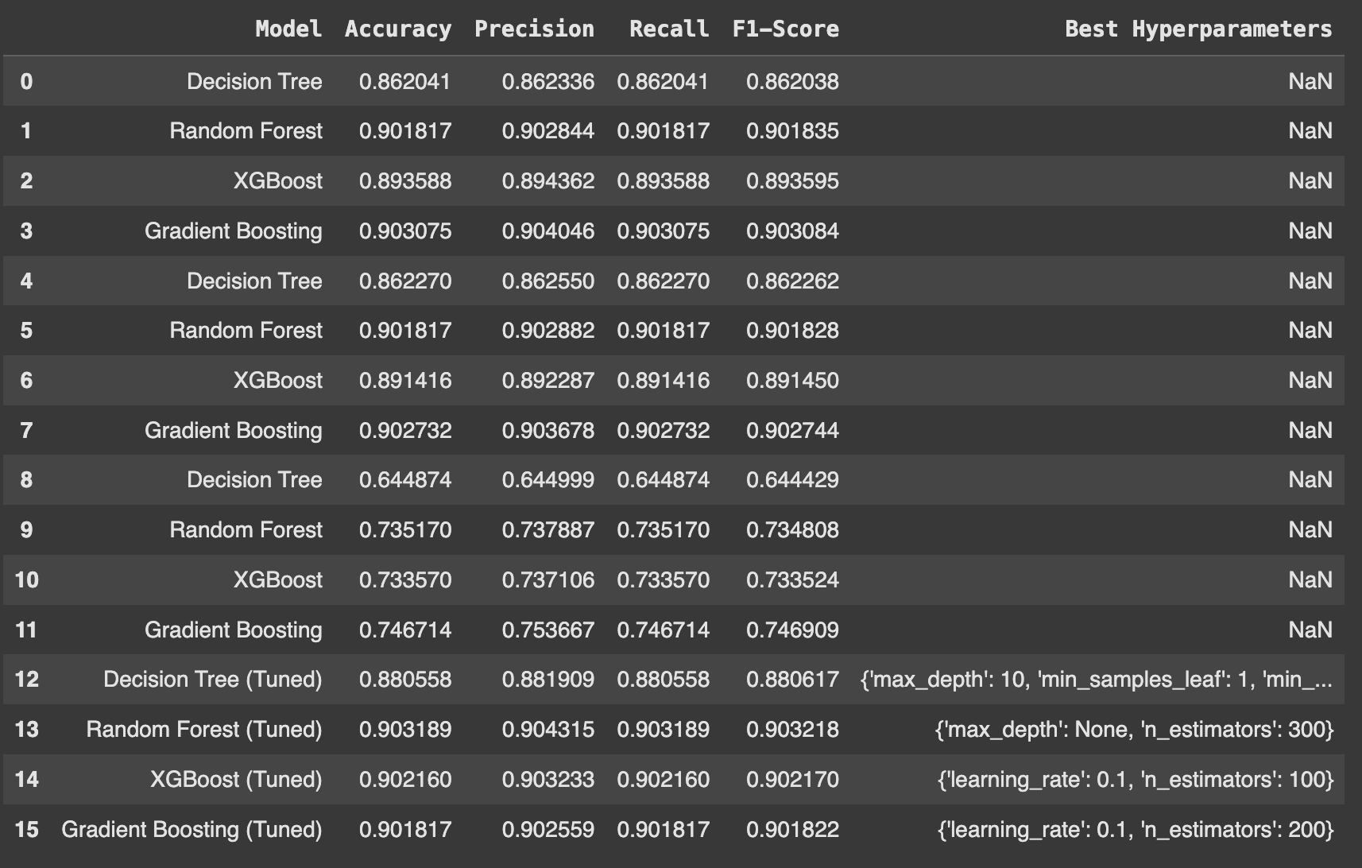
All Models Comparison

Slide 32
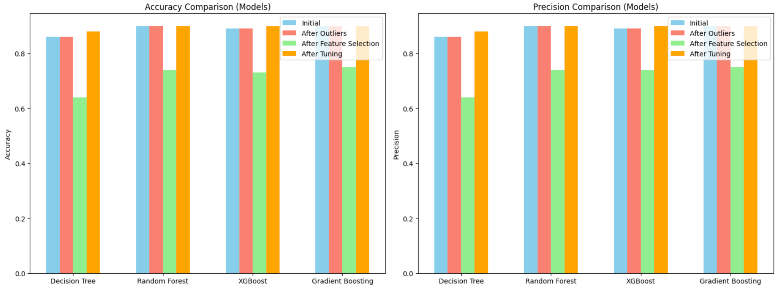

All Models Comparison

Slide 33
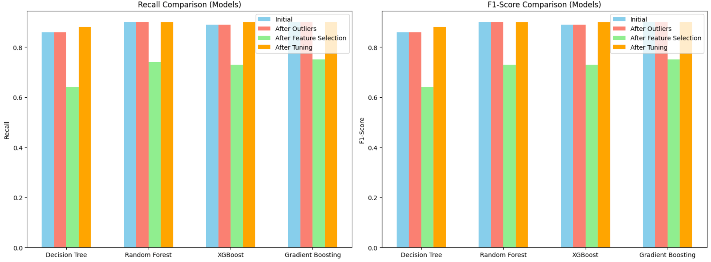
All Models Comparison

Slide 34
06
Challenges
& Future Work
MBTI
MYERS BRIGGS
What is our project about?

Slide 35
Challenges
Long Running Time During Hyperparameter Tuning:
The model training and hyperparameter tuning took too long when trying to optimize multiple hyperparameters. To overcome this, the number of hyperparameters was reduced to make the optimization more efficient and manageable.
Feature Selection Impact:
The feature selection process negatively impacted model performance. Although the intent was to reduce dimensionality, the models performed worse.

Slide 36
Future Work
Utilizing High-Performance Computing (HPC):
To handle long running times more effectively, in the future we could leverage High-Performance Computing (HPC) resources. This would allow for faster model training and hyperparameter tuning.
Ensemble Methods:
In future work, experimenting with ensemble methods like stacking or blending could further improve the performance of the models by combining the strengths of different algorithms.
THE END!

Slide 37
Thank you!
Do you have any questions?

Slide 38
Resources
Predict people personality types. (2025, January 7). Kaggle. https://www.kaggle.com/datasets/stealthtechnologies/predict-people-personality-types

